Slide 1
Parsing III : Top-down Parsing, Part 2
Lecture 8
CS 4318/5531 Spring 2010
Apan Qasem
Texas State University
*some slides adopted from Cooper and Torczon

Slide 2
Review
Top-down parsers
  Grow from root to leaves
  Leftmost derivation
  Scan input from left to right
Issues in parsing
    Ambiguity
    Backtracking
    Left-recursion

Slide 3
Today
Predictive or backtrack free top-down parsing
  The LL(1) Property
    FIRST and FOLLOW sets
  Left Factoring
Simple recursive descent parsers
Table-driven LL(1) parsers

Slide 4
Picking the Right Rule
If it picks the wrong production, a top-down parser may backtrack
Alternative is to look ahead in input and use context to pick correctly
How much lookahead is needed?
    A -> abcdβ
    | abceβ
    | abcfβ
  In general, an arbitrarily large amount
Fortunately,
  Large subclasses of CFGs can be parsed with limited lookahead
  Most programming language constructs fall in those subclasses
Among the interesting subclasses are LL(1) and LR(1) grammars

Slide 5
Predictive Parsing
Basic idea : Given a production rule
A → α | β
the parser should be able to choose between α and β (without having to try out
both alternatives)
Making the right choice means not rejecting a sentence that is in the
language
Recall the definition of recognizing a language
What about accepting a string that is not in the language?
  Cannot happen by picking the wrong rule!

Slide 6
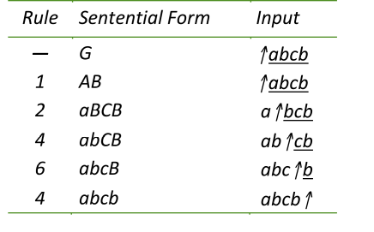
Picking the Right Rule : Example
(Contrived) Grammar
  G → AB
  A → aBC
  A → BC
  B → b
  B → d
  C → c
Input : abcb
Derivation
Input matches derived sentence

Slide 7
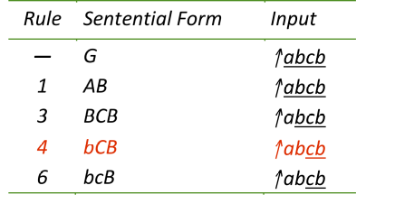
Picking the Right Rule : Example
Grammar
  G → AB
  A → aBC
  A → BC
  B → b
  B → d
  C → c
Input : abcb
different prefix in rhs
We know we have mismatch here

Slide 8
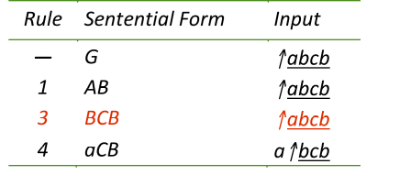
Picking the Right Rule : Example
Grammar
  G → AB
  A → aBC
  A → BC
  B → a
  B → b
  B → d
  C → c
Input : abcb
Derivation
overlapping prefix in rhs
Don’t know whether to apply 2 or 3, just by looking at the next symbol

Slide 9
FIRST sets
We can make the right choice if we know the prefixes of
alternate rules are disjoint
First sets are a formal way of determining the prefix sets
Definition
  For some rhs, α ∈ G, define FIRST(α) as the set of
  terminals that appear as the first symbol in some
  string that derives from α
  That is
x ∈ FIRST(α) iff α ⇒* x γ, for some γ

Slide 10
The LL(1) Property
If A → α and A → β both appear in the grammar, we would like
FIRST(α) ∩ FIRST(β) = ∅
This would allow the parser to make a correct choice with a lookahead of exactly one symbol !
Context-free grammars that have this property are called LL(1) grammars
  The first L stands for left-to-right scanning of input
  The second L stands for leftmost derivation
  1 is for lookahead
CFGs with the LL(1) property allow predictive parsing

Slide 11
Computing FIRST Sets
To compute the FIRST(α) where A → α is a
production in the grammar, apply two rules
If the first symbol in α is a terminal, add the terminal to the set and stop
If the first symbol in α is a non-terminal, recursively expand the NT until you get a terminal; add the terminal to the set and stop
Works if we don’t have any empty productions

Slide 12
FIRST Set : Example
Grammar
  G → AB
  A → aBC
  A → BC
  B → b
  B → d
  C → c
FIRST sets
FIRST(aBC) = {a}
FIRST(BC) = {b, d}
FIRST(aBC) ∩ FIRST(BC) = ∅
FIRST(b) = {b}
FIRST(d) = {d}
FIRST(b) ∩ FIRST(d) = ∅

Slide 13
FIRST Set : Example
Grammar
  G → AB
  A → aBC
  A → BC
  B → a
  B → b
  B → d
  C → c
FIRST sets
FIRST(aBC) = {a}
FIRST(BC) = {a, b, d}
FIRST(aBC) ∩ FIRST(BC) ≠ ∅
FIRST(a) = {a}
FIRST(b) = {b}
FIRST(d) = {d}
FIRST(a) ∩ FIRST(b) ∩ FIRST(d) = ∅

Slide 14
FIRST Set with ε Productions
Grammar
  G → AB
  A → aB
  A → BC
  B → b
  B → d
  B → ε
  C → aC
  C → c
FIRST sets
FIRST(aB) = {a}
FIRST(BC) = {b, d, ε}
FIRST(aB) ∩ FIRST(BC) = ∅
FIRST(b) = {b}
FIRST(d) = {d}
FIRST(ε) = {ε}
FIRST(b) ∩ FIRST(d) ∩ FIRST(ε) = ∅
FIRST(aC) = {a}
FIRST(c) = {c}
FIRST(aC) ∩ FIRST(c) = ∅

Slide 15
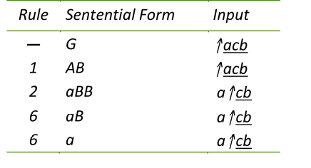
FIRST Set with ε Productions
Grammar
  G → AB
  A → aB
  A → BC
  B → b
  B → d
  B → ε
  C → aC
  C → c
Input : acb
Mismatch!

Slide 16
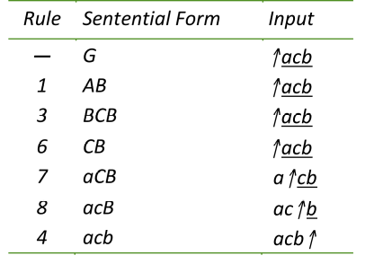
FIRST Set with ε Productions
Grammar
  G → AB
  A → aB
  A → BC
  B → b
  B → d
  B → ε
  C → aC
  C → c
Input : acb
Choose rule 3 even if it doesn’t match the next symbol

Slide 17
Effect of Having ε Productions
Without ε Productions:
For rhs of rule 3
  BC -> bC -> bc
  BC -> dC -> dc
First(BC) = {b, d}
With ε Productions:
For rhs of rule 3
  BC -> bC -> bc
  BC -> dC -> dc
  BC -> C -> aC -> ac
  BC -> C -> c
FIRST(BC) = {a, c, b, d}
Grammar
  G → AB
  A → aB
  A → BC
  B → b
  B → d
  B → ε
  C → aC
  C → c

Slide 18
Computing FIRST Sets With ε Productions : First Draft
To compute the FIRST(α) where A → α is a production in the grammar,
apply two rules
If α = ε, add ε to the set
If the first symbol in α is a terminal, add the terminal to the set and stop
If the first symbol in α is a non-terminal, recursively expand the NT until you get a terminal
  If the terminal is an ε, then go back to 2 and process remainder of alpha
  else add the terminal to the set and stop
Almost works!

Slide 19
FIRST Set with ε Productions
Grammar
  G → AB
  A → aB
  A → BC
  B → b
  B → d
  B → ε
  C → aC
  C → c
FIRST sets
FIRST(aB) = {a}
FIRST(BC) = {b, d, a, c}
FIRST(aB) ∩ FIRST(BC) ≠ ∅
FIRST(b) = {b}
FIRST(d) = {d}
FIRST(ε) = {ε}
FIRST(b) ∩ FIRST(d) ∩ FIRST(ε) = ∅
FIRST(aC) = {a}
FIRST(c) = {c}
FIRST(aC) ∩ FIRST(c) = ∅

Slide 20
More Complications With ε Productions
With ε Productions:
For rhs of rule 3
  B -> b
  B -> d
  B -> ε
  First(B) = {b, d, ε}
But,
G -> AE -> BE -> E -> e
From rhs of rule 3 can derive a string that starts with e
How do we include e in the FIRST(B)?
  Using FOLLOW(A)
Grammar
  G → AE
  A → aB
  A → B
  B → b
  B → d
  B → ε
  C → aC
  C → c
  E → e

Slide 21
Handling ε Productions
ε-productions complicate the definition of LL(1)
According to our first draft, if ε is a member of the FIRST(α) for some production A → α
  Implies A →* ε [do you believe this?]
  If we see A in some rhs then A can vanish
    we need to consider all terminals that can appear after A in any sentential form
    Compute FOLLOW(A)

Slide 22
FOLLOW Sets
…
… → β₁ A β₂
A vanishes, because A →* ε
→ β₁β₂
β₁ vanishes (assume)
→ β₂
Get a string starting with a (assume β₂ →* aβ₃)
→ aβ₃

Slide 23
FOLLOW Sets
…
a FOLLOWS A in sentential form
… → β₁ Aaβ₃
A vanishes, because A →* ε
→ β₁β₂
β₁ vanishes (assume)
→ β₂
Get a string starting with a (assume β₂ →* aβ₃)
→ aβ₃

Slide 24
FOLLOW Sets
FOLLOW(A) is the set of symbols in the grammar that can legally appear immediately after an A in any sentential form
Computing FOLLOW sets
  Identify production rules where A appears on the rhs
    If the grammar symbol to the right of A is a terminal t then add t to FOLLOW(A)
    Else find the FIRST set for the non-terminal following A, add that to the FOLLOW(A)

Slide 25
FOLLOW Set Example
FOLLOW sets
FOLLOW(G) = {EOF}
FOLLOW(A)
G EOF -> AB EOF -> Ab EOF
G EOF -> AB EOF -> Ad EOF
G EOF -> AB EOF -> A EOF
FOLLOW(A) = {b, d, EOF}
FOLLOW(B)
BC -> BaC
BC -> Bc
G -> AB -> aBB -> aBb
G -> AB -> aBB -> aBd
G EOF -> AB EOF
FOLLOW(B) = {a, c, b, d, EOF}
Grammar
  G → AB
  A → aB
  A → BC
  B → b
  B → d
  B → ε
  C → aC
  C → c

Slide 26
FOLLOW Set Example
FOLLOW sets
FOLLOW(G) = {EOF}
FOLLOW(A) = {b, d, EOF}
FOLLOW(B) = {a, c, b, d, EOF}
FOLLOW(C)
G EOF -> AB EOF -> BCB EOF -> BC EOF
G EOF -> AB EOF -> BCB EOF -> BCb EOF
G EOF -> AB EOF -> BCB EOF -> BCd EOF
FOLLOW(C) = {b, d, EOF}
Grammar
  G → AB
  A → aB
  A → BC
  B → b
  B → d
  B → ε
  C → aC
  C → c

Slide 27
Predictive Parsing
If A → α and A → β and ε ∈ FIRST(α), then we need to ensure that FIRST(β) is disjoint from FOLLOW(A), too
Define FIRST⁺(α) as
  if ε ∈ FIRST(α)
    FIRST(α) ∪ FOLLOW(A)
  FIRST(α), otherwise
With ε-productions, a grammar is LL(1) iff A → α and A → β implies
FIRST⁺(α) ∩ FIRST⁺(β) = ∅

Slide 28
Predictive Parsing
Given a grammar that has the LL(1) property
  Can write a simple routine to recognize each lhs
  Code is both simple & fast
Consider A → β₁ | β₂ | β₃, with
  FIRST⁺(β₁) ∩ FIRST⁺ (β₂) ∩ FIRST⁺ (β₃) = ∅

Slide 29
Predictive Parsing
/* find an A */
if (current_symbol ∈ FIRST(β₁))
find a β₁ and return true
else if (current_symbol ∈ FIRST(β₂))
find a β₂ and return true
else if (current_symbol ∈ FIRST(β₃))
find a β₃ and return true
else
report an error and return false
Grammars with the LL(1) property are called predictive grammars because the parser can “predict” the correct expansion at each point in the parse.
Parsers that capitalize on the LL(1) property are called predictive parsers.
One kind of predictive parser is the recursive descent parser.
Of course, there is more detail to “find a β_{i}” (§ 3.3.4 in EAC)

Slide 30
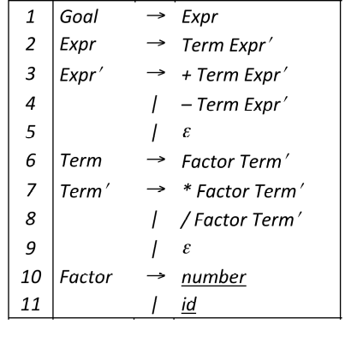
Recursive Descent Parsing
This produces a parser with six mutually recursive routines
  Goal
  Expr
  EPrime
  Term
  TPrime
  Factor
Each recognizes one NT or T
The term descent refers to the direction in which the parse tree is built.

Slide 31
Routines from the Expression Parser
Goal( )
token ← next_token( );
if (Expr( ) = true & token = EOF)
then next compilation step;
else
report syntax error;
return false;
Expr( )
if (Term( ) = false)
then return false;
else
return Eprime( );
Factor( )
if (token = Number) then
token ← next_token( );
return true;
else if (token = Identifier) then
token ← next_token( );
return true;
else
report syntax error;
return false;
EPrime, Term, & TPrime follow the same basic lines (Figure 3.7, EAC)
looking for EOF,
found token
looking for Number or Identifier, found other token instead

Slide 32
Recursive Descent Parsing
To build a parse tree:
  Augment parsing routines to build nodes
  Pass nodes between routines using a stack
  Node for each symbol on rhs
  Action is to pop rhs nodes, make them children of lhs node, and push this subtree
To build an abstract syntax tree
Build fewer nodes
Put them together in a different order
Expr( )
result ← true;
if (Term( ) = false)
then return false;
else if (EPrime( ) = false)
then result ← false;
else
build an Expr node
pop EPrime node
pop Term node
make EPrime & Term
children of Expr
push Expr node
return result;
Success ⇒ build a piece of the parse tree

Slide 33
Left Factoring
What if a CFG does not have the LL(1) property?
Sometimes, we can transform the grammar

Slide 34
The Algorithm
∀ A ∈ NT,
find the longest prefix α that occurs in two
or more right-hand sides of A
if α ≠ ε then replace all of the A productions,
A → αβ₁ | αβ₂ | … | αβ_{n} | γ ,
with
A → α Z | γ
Z → β₁ | β₂ | … | β_{n}
where Z is a new element of NT
Repeat until no common prefixes remain

Slide 35
Left Factoring : Example
αβ₁
A → αβ₁
| αβ₂
| αβ3
A
αβ₂
αβ₃
A → α Z
Z → β₁
| β₂
| β_{n}
β₁
A
αZ
β₂
β₃

Slide 36
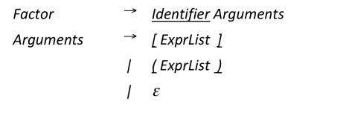
Left Factoring : Example
From our knowledge of C (and without the knowledge of the entire grammar) can we determine if the alternated productions of Arguments has the LL(1) property?
For the LL(1) condition to hold FOLLOW(Factor) cannot include ‘[‘ or ‘(‘ ?
Three possible expansions for Factor
  foo
  foo [i]
  foo (17)
If [‘ or ‘(‘ is in FOLLOW(Factor) then possible to generate:
    foo (17) [i]
    foo (17) (17)
FIRST(rhs₁) = { Identifier }
FIRST(rhs₂) = { [ }
FIRST(rhs₃) = { ( }
FIRST(rhs₄) = FOLLOW(Arguments)
= FOLLOW(Factor)

Slide 37
Left Factoring : Example
More generally, can’t have a production of the form
  α -> β Factor γ
where FIRST(γ) contains ‘(‘ or ‘[‘
Hence, FOLLOW(Factor) does not contain ‘(‘ or ‘[‘
Grammar has LL(1) property
Are we forgetting something?
FIRST(rhs₁) = { Identifier }
FIRST(rhs₂) = { [ }
FIRST(rhs₃) = { ( }
FIRST(rhs₄) = FOLLOW(Arguments)
= FOLLOW(Factor)

Slide 38
Left Factoring : Example
Are we forgetting something?
Cannot express syntax for multi-dimensional arrays in C!
foo [17][17]
Need to modify the grammar
FIRST(rhs₁) = { Identifier }
FIRST(rhs₂) = { [ }
FIRST(rhs₃) = { ( }
FIRST(rhs₄) = FOLLOW(Arguments)
= FOLLOW(Factor)

Slide 39
Left Factoring : Example
Identifier
Factor
Identifier
[
ExprList
]
Identifier
(
ExprList
)
No basis for choice
ε
Factor
Identifier
[
ExprList
]
(
ExprList
)
Word determines correct choice

Slide 40
Complexity of Left Factoring and Left Recursion
Question
  By eliminating left recursion and left factoring, can we transform an arbitrary CFG to a form where it meets the LL(1) condition? (and can be parsed predictively with a single token lookahead?)
Answer
  Given a CFG that doesn’t meet the LL(1) condition, it is undecidable whether or not an equivalent LL(1) grammar exists.
Example
  {a^{n} 0 b^{n} | n ≥ 1} ∪ {a^{n} 1 b^{2n} | n ≥ 1} has no LL(1) grammar

Slide 41
Language That Cannot Be LL(1)
Example
{a^{n} 0 b^{n} | n ≥ 1} ∪ {a^{n} 1 b^{2n} | n ≥ 1} has no
LL(1) grammar
G → aAb
| aBbb
A → aAb
| 0
B → aBbb
| 1
Problem: need an unbounded number of
a characters before you can determine
whether you are in the A group or the B
group.

Slide 42
Language That Cannot Be LL(1)
Example
{a^{n} 0 b^{n} | n ≥ 1} ∪ {a^{n} 1 b^{2n} | n ≥ 1} has no
LL(1) grammar
Attempt at Left Factoring
G → aZ
Z -> Ab
| Bbb
???
G → aAb
| aBbb
A → aAb
| 0
B → aBbb
| 1

Slide 43
Recursive Descent Summary
Modify grammar to have LL(1) condition
  Remove left recursion
  Build FIRST (and FOLLOW) sets
  Left factor it
Define a procedure for each non-terminal
  Implement a case for each right-hand side
  Call procedures as needed for non-terminals
Add extra code, as needed
  Perform context-sensitive checking
  Build an IR to record the code
Can we automate this process?

Slide 44
Building Top-down Parsers
Given an LL(1) grammar, and its FIRST & FOLLOW sets …
  Emit a routine for each non-terminal
    Nest of if-then-else statements to check alternate rhs’s
    Each returns true on success and throws an error on false
    Simple, working (, perhaps ugly,) code
  This automatically constructs a recursive-descent parser
Improving matters
  Nest of if-then-else statements may be slow
    Good case statement implementation would be better
  What about a table to encode the options?
    Interpret the table with a skeleton

Slide 45
Building Top-down Parsers
Strategy
Encode knowledge in a table
Use a standard “skeleton” parser to interpret the table
Example
In the Expression grammar, the non-terminal Factor has two expansions
  Identifier or Number
Table might look like:
Terminal Symbols
 | + | - | * | / | id | num | EOF
Factor | — | — | — | — | 10 | 11 | —
Non-terminal
Symbols
Error on +
Reduce by rule 10 on id

Slide 46
Building Top-down Parsers
Building the complete table
  Need a row for every NT & a column for every T
  Need a table-driven interpreter for the table
Filling in entries TABLE[X, y], X ∈ NT, y ∈ T
    Entry is the rule X → β, if y ∈ FIRST⁺(X → β)
    Error if (1) doesn’t apply

Slide 47
LL(1) Skeleton Parser
token ← next_token()
push EOF onto Stack
push the start symbol, S, onto Stack
TOS ← top of Stack
loop forever
if TOS = EOF and token = EOF then
break & report success
else if TOS is a terminal then
if TOS matches token then
pop Stack // recognized TOS
token ← next_token()
else report error looking for TOS
else // TOS is a non-terminal
if TABLE[TOS,token] is A→ B₁B₂…B_{k} then
pop Stack // get rid of A
push B_{k}, B_{k-1}, …, B₁ // in that order
else report error expanding TOS
TOS ← top of Stack
exit on success

Slide 48
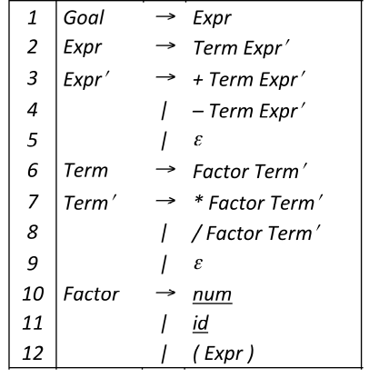
Table-Driven Predictive Parser: Example
FIRST Sets
1
2
3
4
5
6
7
8
9
10
11
12
(, id, num
(, id, num
+
-
ε
(, id, num
*
/
ε
num
id
(

Slide 49
Table-Driven Predictive Parser: Example
FOLLOW Sets
Goal
Expr
Expr’
Term
Term’
Factor
EOF
), EOF
), EOF
+, -, ), EOF
+, -, ), EOF
+, -, *, /, EOF

Slide 50
Table-Driven Predictive Parser: Example
FIRST⁺ Sets
1
2
3
4
5
6
7
8
9
10
11
12
(, id, num
(, id, num
+
-
ε
(, id, num
*
/
ε
num
id
(

Slide 51
1 | (, id, num
2 | (, id, num
3 | +
4 | -
5 | ε, ), EOF
6 | (, id, num
7 | *
8 | /
9 | ε, +, -, ), eof
10 | num
11 | id
12 | (
 | + | - | * | / | id | num | ( | ) | EOF
Goal | - | - | - | - | 1 | 1 | 1 | - | -
Expr | - | - | - | - | 2 | 2 | 2 | - | -
Expr’ | 3 | 4 | - | - | - | - | - | 5 | 5
Term | - | - | - | - | 6 | 6 | 6 | - | -
Term’ | 9 | 9 | 7 | 8 | - | - | - | 9 | 9
Factor | - | - | - | - | 11 | 10 | 12 | - | -

